Slide 1
2020-21 Wellness Program
August 15, 2020 to August 13, 2021

Slide 2
Wellness Program Overview
The 2020-21 program opens November 16, 2020 (with a look-back to August 15, 2020 for credit) and will end on August 13, 2021. Any activity completed beginning August 15, 2020 will count for credit.
All employees and spouses with current medical coverage through CEBCO/Anthem are eligible and encouraged to participate in this free and voluntary program.
Incentives may be available to you for participation, such as reduced insurance premium, cash, gift card, and/or entries for prizes. For details about this please contact your employer or the county you are insured through.
The Wellness Program is managed by CEBCO and administered in partnership with HealthWorks, an Ohio-based wellbeing company with over 20 years of experience in the industry.

Slide 3
Program Purpose
Assist with maintaining or improving their personal health and wellbeing through the following opportunities:
Provides convenient ways to have annual bloodwork completed with comprehensive results that allow for early detection of heath risks/conditions.
Creates a relationship with a primary care physician (PCP), an important component in your personal healthcare.
Provides resources such as health coaching and online tools to make lifestyle changes and ultimately improve health.

Slide 4
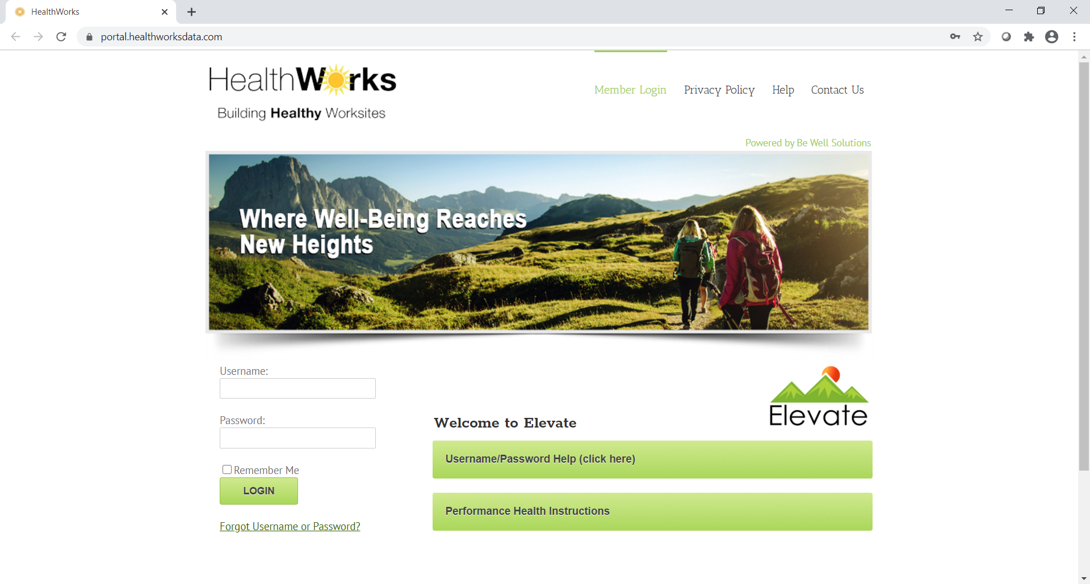
To Participate, Create An Account
Go to https://portal.healthworksdata.com
Each individual user must provide a unique email address.
Your username is: the first letter of your first name, the first four letters of your last name, and the last four of your SSN.
EXAMPLE: Amy Smith, 1234 = asmit1234
Temporary password for new users is APPLE.
For technical assistance or log-in issues, please contact HealthWorks:
513-751-1288 (7a-6p, M-F)
CEBCOwellness@cincyhealthworks.com

Slide 5
Program Activities: 600 Point Goal
ACTIVITY | POINT VALUE PER ACTIVITY/MAX COMPLETION | MAXIMUM POINT VALUE AVAILABLE
CORE REQUIREMENT #1: Health Evaluation (includes 50 points for receiving a Personal Health Score & Goal) | 200 points (max of 1) | 200 (150 points for the health evaluation + 50 points for the PHS & Goal)
CORE REQUIREMENT #2: Annual Routine Check-Up (Physical) | 100 points (max of 1) | 100
Select and complete a minimum of 300 points in elective activities below; 600-point goal.
Share Lab Results with Doctor | 50 points (max of 1) | 50
Preventive Care | 50 points (max of 2) | 100
Log Steps/Activity | 1 point for 7500 steps per day (max of 1 point per day) | 100
25-Point Community Activities | 25 points each (max of 6) | 150 (any combo)
50-Point Community Activities | 50 points each (max of 3)
Online Workshops & Challenges | 25 points each (up to 2 of each) | 100

Slide 6
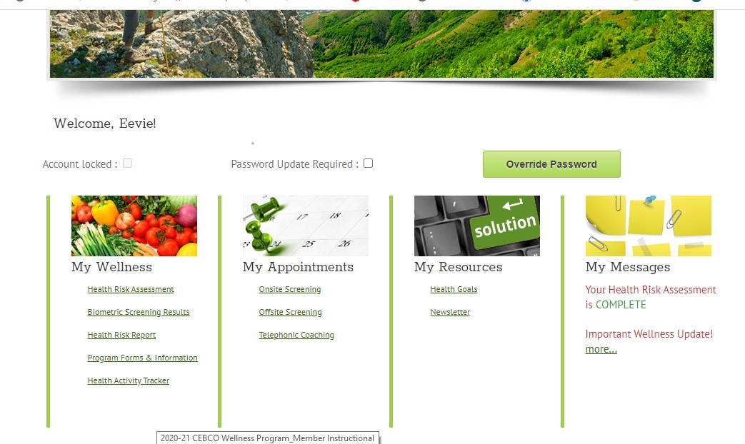
To Track & Report Points
Go to Health Activity Tracker from the Homepage, under “My Wellness”.
This is where points will be loaded for completing the core requirements and online activities and where to self-report all other activities available.

Slide 7
Health Evaluation (Core Requirement #1)
Choose ONE of the following options:
Onsite at the workplace
Test at any LabCorp location
Physician (a form must be completed by physician’s office for return)
*Important Health Evaluation Information*
All health evaluations (bloodwork) are billed as insurance claims. Participants will get an EOB (explanation of benefits) showing $0 responsibility as the cost is covered at 100%.
For those choosing to get their bloodwork ordered by their physician: be sure to tell the office it’s for routine/preventive purposes so they bill it to insurance that way.

Slide 8
NEW Annual Check-Up (Core Requirement #2)
Done with a primary care at the provider’s office or through video chat (not by phone). All routine visits that are in-person or through video chat AND billed as preventive will be covered at 100% (no cost to the member).
A PCP is the coordinating entity for ones’ healthcare; they help patients stay healthy and catch problems early.
All preventive exams and immunizations including an annual check-up are covered under insurance benefits at no cost to you when billed as routine/preventive.
Be sure to use an in-network provider and you will pay $0 for your annual check-up and any other preventive screenings that are appropriate for your age & gender.
*IMPORTANT Annual Check-Up Information*
Schedule your check-up as routine so it’s put through to insurance as preventive and covered in full.
If you are having problems finding primary care accepting new patients, go to the Engage App, hit find care, then type in primary care for adults OR contact Anthem.

Slide 9
Comprehensive Health Evaluation Onsite & lab options include the following results:
Glucose & Uric Acid | Kidney (Renal) | Electrolytes | Liver (Hepatic) | Lipids | Complete Blood Count
Glucose, Serum | BUN | Sodium, Serum | Protein, Total, Serum | Cholesterol, Total | WBC
Uric Acid, Serum | Creatinine, Serum | Potassium, Serum | Albumin, Serum | Triglycerides | RBC
A1C | eGFR | Chloride, Serum | Globulin, Serum | HDL Cholesterol | Hemoglobin
 | BUN/Creatinine Ratio | Calcium, Serum | A/G Ratio | VLDL Cholesterol Cal | Hematocrit
 | Osmolality (Calc) | Phosphorus, Serum | Bilirubin, Total | LDL Cholesterol Cal | MCV
 |  |  | Alkaline Phosphatase, S | T. Chol/HDL Ratio | MCH
 |  |  | LDH |  | MCHC
 |  |  | AST (SGOT) |  | RDW
 |  |  | ALT (SGPT) |  | Platelets
 |  |  | GGT
 |  |  | Iron, Serum
NOTE: Blood pressure is taken for all participants and thyroid is added for women age 40+.

Slide 10
Other Important Info
The last day to complete core requirements (health evaluation or annual check-up) is Thursday, 8/12/21.
The last day to submit forms or log activity is Friday, 8/13/21. Forms may be returned using the following methods:
Upload to the portal through HealthWorks account, under the Healthy Activity Tracker.
Fax to (513)-751-0018
Scan/email to: CEBCOwellness@cincyhealthworks.com
Mail to HealthWorks located at 4329-B Red Bank Rd., Cincinnati, OH 45227
This program is fully compliant with federal wellness rules. HealthWorks is required by law to maintain privacy and security of personal health information (PHI). PHI is not shared with any entity including CEBCO (your plan sponsor), Anthem (your insurance carrier), or your employer.
If it is medically inadvisable for a member to participate in any aspect of this program, which may be required to earn an incentive, the member may contact HealthWorks at 513-751-1288 or at CEBCOwellness@cincyhealthworks.com to request a RAS/Waiver. The form must be completed by the member’s physician and returned to HealthWorks no later than 8/13/21. Please request the form at least two weeks prior to this deadline.

